Slide 1
Btn2
Btn3
Bnt4
Bnt5

Slide 2
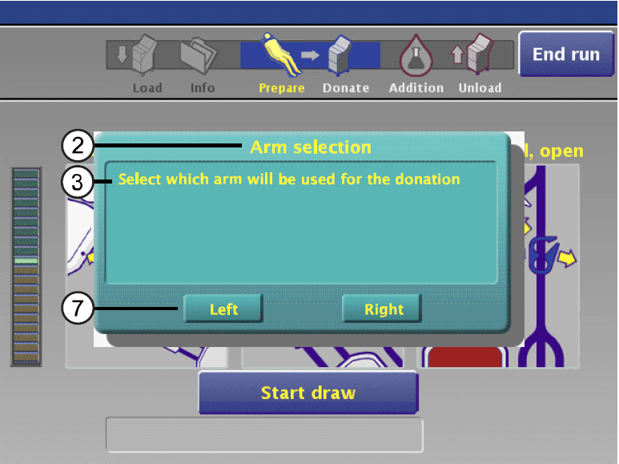
Arm selection
Select which arm will be used for the donation
Btn1
Btn2
Btn3
Bnt4
Bnt5

Slide 3
